Slide 1

P peline
The Data
Human Centered Issues in Data Acquisition
© Jennifer Mankoff
The Data Pipeline; HCII; Spring 2015

Slide 2
Goals
After this, you should be able to:
Understand the key components of the data pipeline
Have a sense of what material this course does and does not cover
Know about the work expectations in the course
Have information about how to start collecting your own data from your phone
Adapted from http://www.fordham.edu/economics/Vinod/correl-regr.ppt

Slide 3
Stay in the room if you want to
Learn about problems with data collection, use and interpretation
Learn about techniques for visualizing and interpretation of data
Explore applied examples of data use
Explore the end user experience of data
Develop a portfolio of data-driven applications
Collect your own data and analyze it
Notes:
Close your laptop and phone please

Slide 4
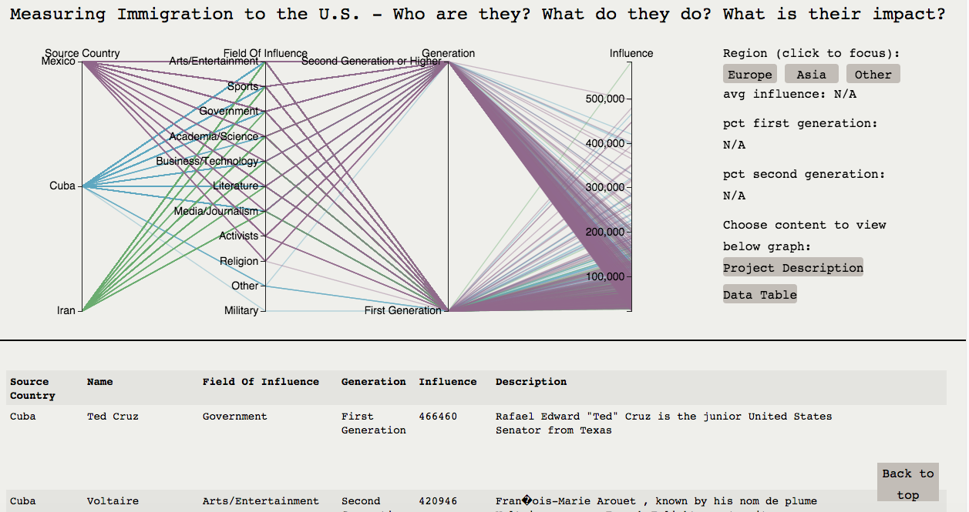
Some examples: Influential Immigrants
http://root-arcanum-92800.appspot.com/

Slide 5
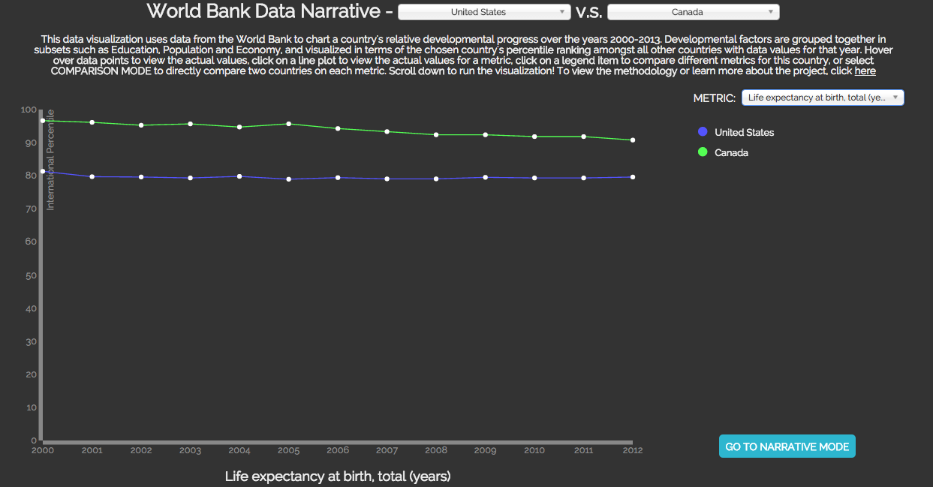
Some examples: Development Progress
http://iamohcy.com/worldbankvisualization/

Slide 6
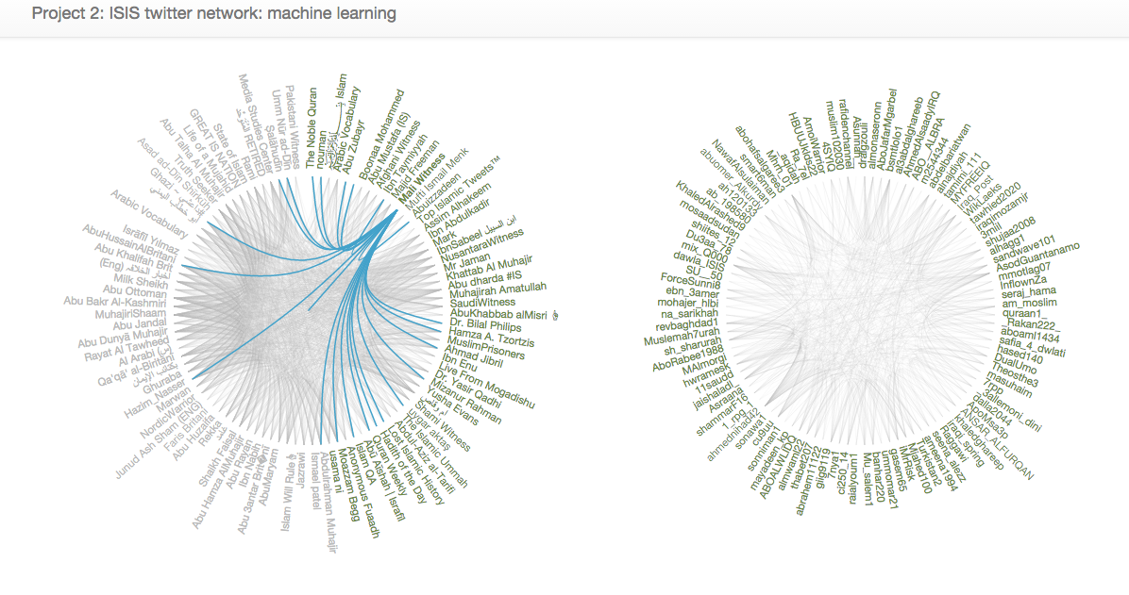
Some examples: Fighting ISIS
http://project2-isistweet.appspot.com/

Slide 7
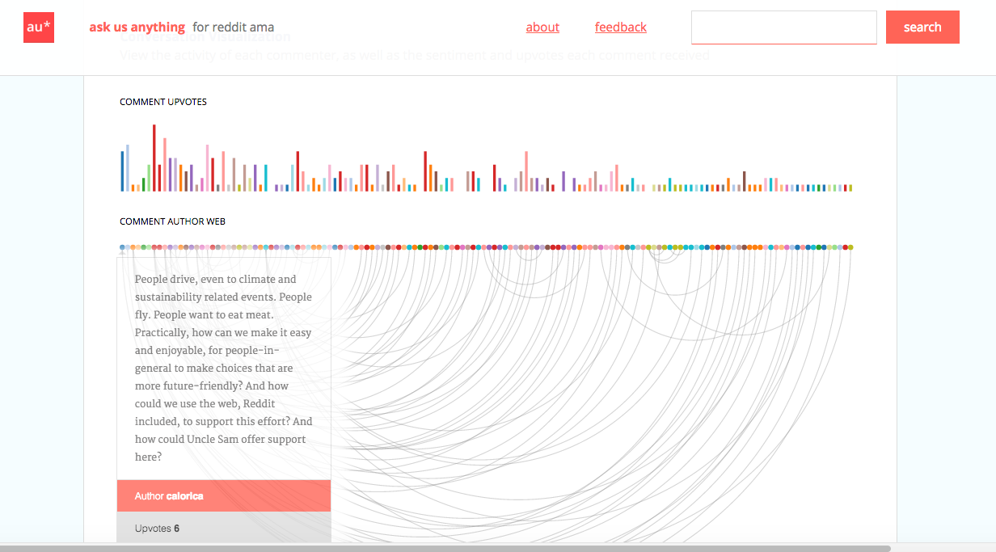
Some examples: Reddit AMA
http://askusanything.cc/thread?id=40e1jk

Slide 8
This year: More focus on YOU
Mobile
Study

Slide 9
Data Related degrees at CMU
http://www.cmu.edu/graduate/data-science/
College | Degree | Length (yrs) | Background | Jobs
Heinz | MS in Public Policy (Analytics Track) | 2 | Business/science/tech | Think tanks
 | MISM (Business Intelligence & Analytics track) | 1.5 | Technical Degree/Wk Experience | Finance/IT
Tepper | MBA (Analytics track) | 2 | Diverse | Finance/IT/
LTI | MCDS/MII/MLT(Rsrch) | 1-2 | CS | SE /PhD
HCII | M Education Tech | 1 | Pysch/Ed/Cs/… | Diverse
MLD | MML (coursework only) | 1.5 | CS/Stats | SE/Finance/PhD
Dept. Stats | M in Statistical Practice | 1 | Math/Stats | Consulting/Finance/Marketing
Notes:
MCDS = Masters in Computational Data Science. MLT = Masters in Learning Techology (research masters). SE = Software Engineering

Slide 10
Sampling of courses at CMU
70455 Modern Data Management ([S14]; Business Administration)
19704 Applied Data Analysis ( [S14]; EPP)
67362 Big Data Analytics ([S14]; H&SS Information Systems)
95791 Data Mining ([F13 & S14]; IS school of IS & Mgmt)
95868 Exploring and Visualizing Data ([S14]; IS school of IS & Mgmt)
08741 Seminar in Data Science ( [F13 & S14]; Institute for Software Research)
08711 Data Mining, CRM ([F13 & S14]; Institute for Software Research)
08749 Data Science Systems Capstone ([F13]; Institute for Software Research)
15648 Studio in Big Data Systems ([S14]; Computer Science)
15649 Seminar Data Systems ([S14]; Computer Science)
15826 Multimedia Databases and Datamining ([F13]; Computer Science)
94832 Business Intelligence & Data Mining SAS ([S14] & Li [F13]; Heinz [S])
11675 Big Data Systems for Biotechnology ( [S14], Vu [F13]; LTI)
10605 Machine Learning with Large Datasets ( [S14]; Machine Learning)
91801 Data Analysis for Managers ( [S14][F13]; Public Management)
90866 Large Scale Data Analysis for Public Policy ( [S14]; Public Policy & Mgmt)
36402/36608 Advanced Methods for Data Analysis ([S14]; Statistics)
36601 Perspectives in Data Science I ([F13]; Statistics)
36602 Perspectives in Data Science II ([S14]; Statistics)
36618 Topic in Data Analysis [S14]; Statistics)
36757 Advanced Data Analysis I ([S14]; Statistics)
36758 Advanced Data Analysis II ([F13]; Statistics)
45851 Data Mining ([S14]; Tepper)
45980 Big Data ( [S14]; Tepper)
05434 Machine Learning in Practice ( [S14 & F13]; HCI)
05839 The Data Pipeline: Collecting and Using Data for Interactive Systems ([S14]; HCI)
12740 Data Acquisition ([F13]; CEE)
12741 Data Management ( [F13]; CEE)

Slide 11
The Courses in Profile

Slide 12
Jen’s Profile

Slide 13
Think Skills Not Area

Slide 14
What’s your profile?
Fill out: data.cmubi.org/classroom-news/2016studentpoll

Slide 15
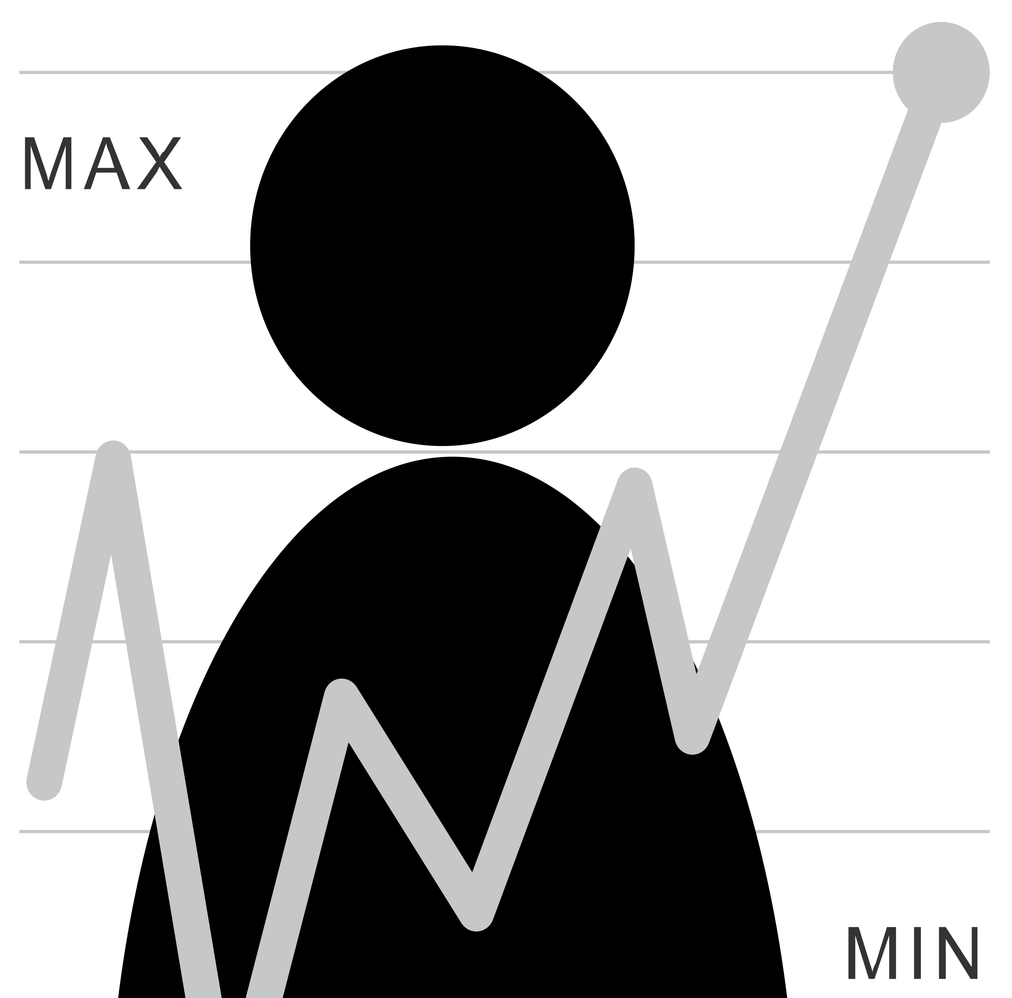
What is the Data Pipeline?
How much do I exercise?
What kind of question is this? Is it a good or a bad one? Can we rephrase it?
What sort of data could help answer it? What would a user need to do to collect good quality data? What would they do with the data?
Question
Is it the right question?
Collect Data
Is it the right data for the question?
How hard/easy is it to collect?
Is it answerable?
Stats/Graphs/ML
Intuition
Explore Data

Slide 16
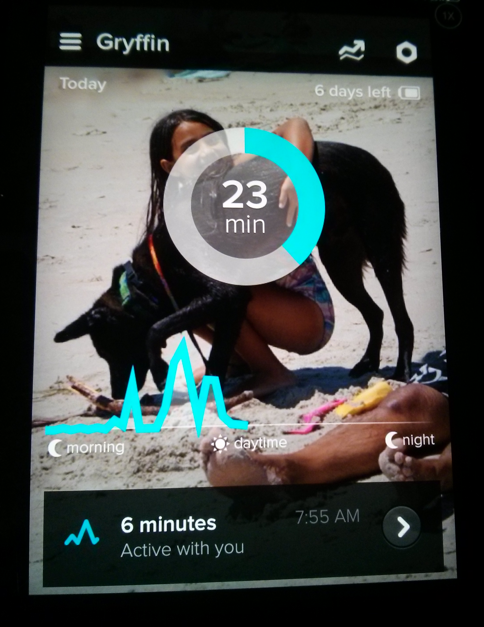
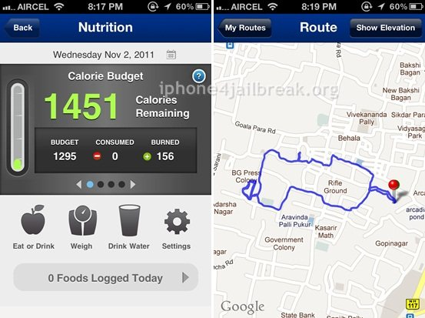
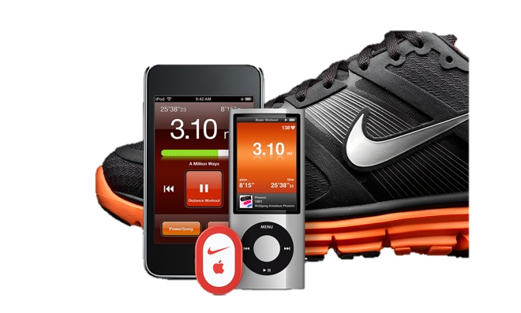
Example: Mobile data collection; Identifying activity

Slide 17
What is the Data Pipeline?
Question
Is it the right question?
Collect Data
Is it the right data for the question?
How hard/easy is it to collect?
Is it answerable?
Stats/Graphs/ML
Intuition
Explore Data

Slide 18
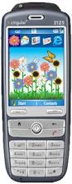
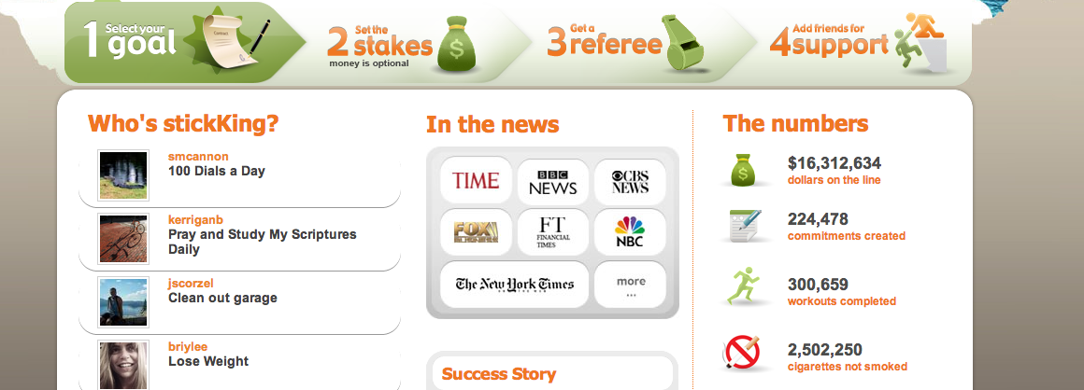
It’s not all about data…

Slide 19
It’s not all about data…
… and even if it was …

Slide 20
What is the Data Pipeline?
Question
Is it the right question?
Collect Data
Is it the right data for the question?
How hard/easy is it to collect?
Clean Data
What flaws exist in the data?
How do we address them?
Is it answerable?
Explore Data
Stats/Graphs/ML
Intuition

Slide 21
Can you trust your data?
Just because you have a lot of data, does not mean that it is good data The plural of “anecdote” is not “data”.
Content borrowed from Bill Thies

Slide 22
Four C’s of Data Quality
Is your data Complete?
Is your data Coherent?
Is your data Correct?
Is your data aCcountable?

Slide 23
What is the Data Pipeline?
Question
Is it the right question?
Collect Data
Is it the right data for the question?
How hard/easy is it to collect?
Clean Data
What flaws exist in the data?
How do we address them?
Is it answerable?
Explore Data
Stats/Graphs/ML
Intuition

Slide 24
Unlike laboratory data,
real world data is not easily segmented by task
Notes:
Analyzing real world data is more complicated than analyzing laboratory data. One reason is that laboratory log data is typically “segmented” by task (or intent) which is usually clear because the experimenter tells the participant what to do. However, when studying real world data, we do not know the user’s tasks and the only information we have to work with are long logs of event data.
Since we don’t know intent, we segment data according to events captured by CRUMBS that are relevant to the assessments we want to make. In this thesis we focus on targeting motions, so we segment data by button events and pauses.

Slide 25
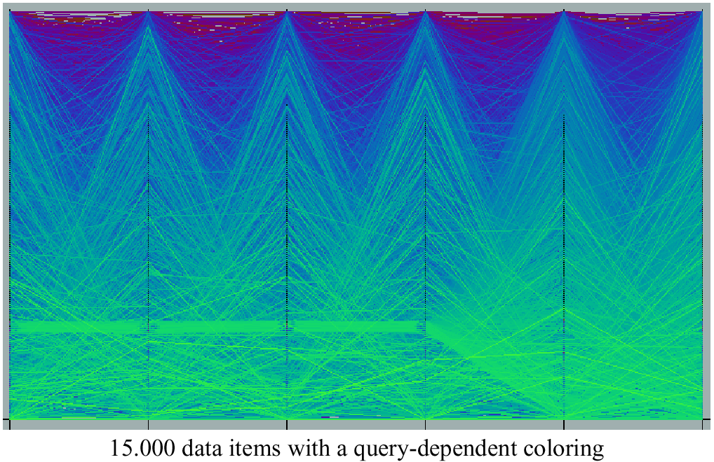
Query Dependent Coloring

Slide 26
Characterizing Performance: Slipping
Notes:
User unintentionally moves cursor while button is pressed [Trewin et al. 2006]

Slide 27
What is the Data Pipeline?
Question
Is it the right question?
Collect Data
Is it the right data for the question?
How hard/easy is it to collect?
Clean Data
What flaws exist in the data?
How do we address them?
Is it answerable?
Explore Data
Stats/Graphs/ML
Use data
Communicate/Predict/…
Intuition

Slide 28
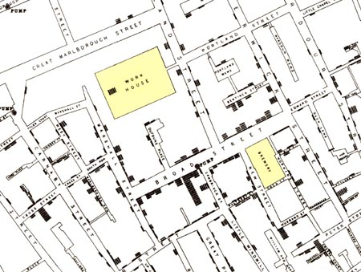
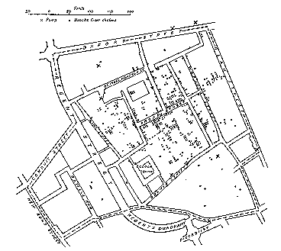
Success – user learned something
Illustration of John Snow’s
deduction that a cholera epidemic
was caused by a bad water pump, circa 1854.
Horizontal lines indicate location of deaths.
From Visual Explanations by Edward Tufte, Graphics Press, 1997
Notes:
This map was actually made POST discovery (he used interviews to identify the problem first). What does this tell you about where intuition comes from?...

Slide 29
A full data pipeline
Question
Is it the right question?
Collect Data
Is it the right data for the question?
How hard/easy is it to collect?
Clean Data
What flaws exist in the data?
How do we address them?
Is it answerable?
Explore Data
Intuition
Use data
Communicate/Predict/…
Stats/Graphs/ML
Report on Findings
Visualize

Slide 30
Where are end users implicated?
Question
Is it the right question?
Collect Data
Is it the right data for the question?
How hard/easy is it to collect?
Clean Data
What flaws exist in the data?
How do we address them?
Is it answerable?
Explore Data
Intuition
Use data
Communicate/Predict/…
Stats/Graphs/ML
Report on Findings
Visualize

Slide 31
Where are end users implicated?
Question
Is it the right question?
Collect Data
Is it the right data for the question?
How hard/easy is it to collect?
Clean Data
What flaws exist in the data?
How do we address them?
Is it answerable?
Explore Data
Intuition
Use data
Communicate/Predict/…
Stats/Graphs/ML
Report on Findings
Visualize

Slide 32
Where are end users implicated?
Question
Is it the right question?
Collect Data
Is it the right data for the question?
How hard/easy is it to collect?
Clean Data
What flaws exist in the data?
How do we address them?
Is it answerable?
Explore Data
Intuition
Use data
Communicate/Predict/…
Stats/Graphs/ML
Report on Findings
Visualize

Slide 33
Where are end users (and HCI) implicated?
Question
Is it the right question?
Collect Data
Is it the right data for the question?
How hard/easy is it to collect?
Clean Data
What flaws exist in the data?
How do we address them?
Is it answerable?
Explore Data
Intuition
Use data
Communicate/Predict/…
Stats/Graphs/ML
Report on Findings
Visualize

Slide 34
Administrata
Class Participation: No Phones or Laptops
Why? “students who multitask on laptops in class distract not just themselves but also their peers” http://www.sciencedirect.com/science/article/pii/S0360131512002254#
Reading assignments: two edits to piazza on day before each reading is due

Slide 35
Administrata
Class Participation: No Phones or Laptops
Participation in Balanced Campus Study (optional)

Slide 36
Administrata
Class Participation: No Phones or Laptops
Participation in Balanced Campus Study
Several small “Byte” sized exercises
Stepping stones to larger projects
Peer graded
Individual work
Tutorials and some sample code provided
First one due Monday

Slide 37
Byte1 (Due Thursday next week)
Ask a question using fusion tables [swap decks]
Notes:
Let’s look in more depth… (swap decks)

Slide 38
Byte 2
jmankoff-explore.appspot.com
Use data from Google Fusion Tables (& SQL)
Use a key to access an API
Using CSV and JSON
Read and write from files
Make an interactive website
Conducting exploratory data analysis

Slide 39
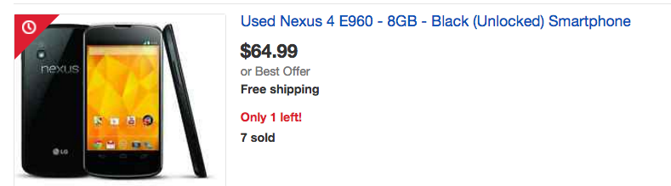
Byte 3
jmankoff-mobile.appspot.com
Your own data
INSTALL DUE TUESDAY
REQUIRED HARDWARE: Android or iPhone

Slide 40
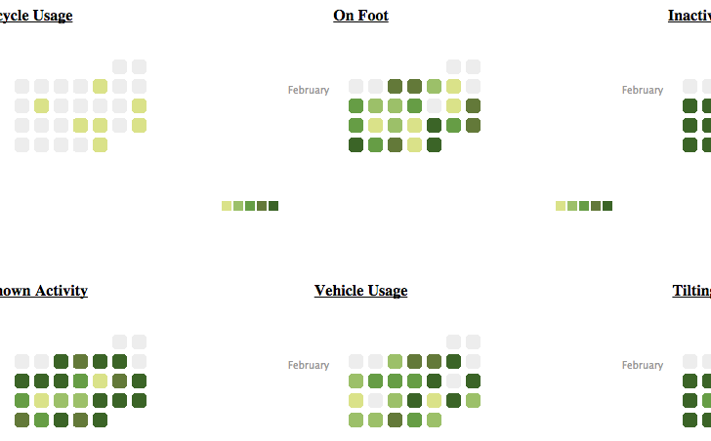
Example

Slide 41
Byte 4
Develop a data visualization that tells a story about a data set of your choice
Goal: explore the art of visual portraiture

Slide 42
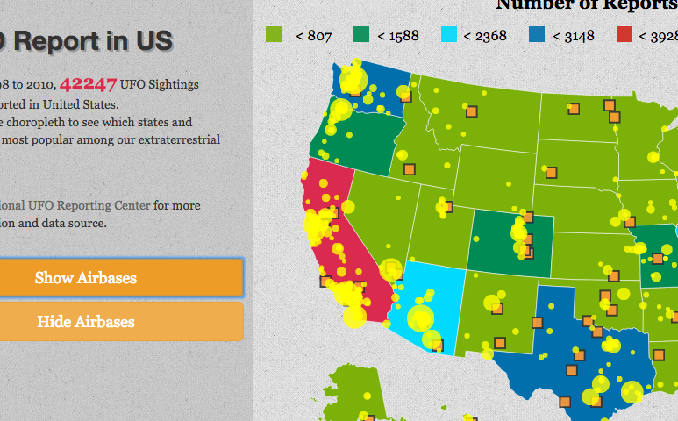
Example: jianf-proj1.appspot.com

Slide 43
Byte 5
Statistical Hypothesis Testing & Prediction

Slide 44
Administrata
Class Participation: No Phones or Laptops
Participation in Balanced Campus Study
Several small “Byte” sized exercises
One larger project
Very self-defined
May be done in groups
Peer graded with instructor feedback

Slide 45
Final Project:
Goal: Develop an experience with providing interactive access to data
Select an audience
Select data that is effective for your goals
Document your data
You may work in groups on this project
Last Year’s Awesome Results! http://bit.ly/1ZVKeEu

Slide 46
Administrata
Class Participation: No Phones or Laptops
Participation in Balanced Campus Study
Several small “Byte” sized exercises
One larger projects
Weekly quizzes & 1 take home final exam
Quizzes small and unannounced

Slide 47
Grading
10% Class Participation
30% Project Bytes [peer graded]
50% Full Projects
10% Final Exam

Slide 48
Pre-requisites
Aim to engage a range of programming abilities (primarily using python)
Comfort with programming and debugging important
Byte 1 (first assignment) will help you judge: due Monday for this reason
We assume no background in machine learning, databases, or statistics.

Slide 49
Other details
Large class, small staff (just me right now!)
Other Details
Some Guest lectures still TBD
In-class Hack Sessions & Presentations for Instructor Feedback

Slide 50
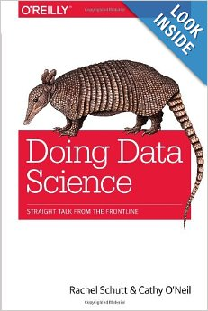
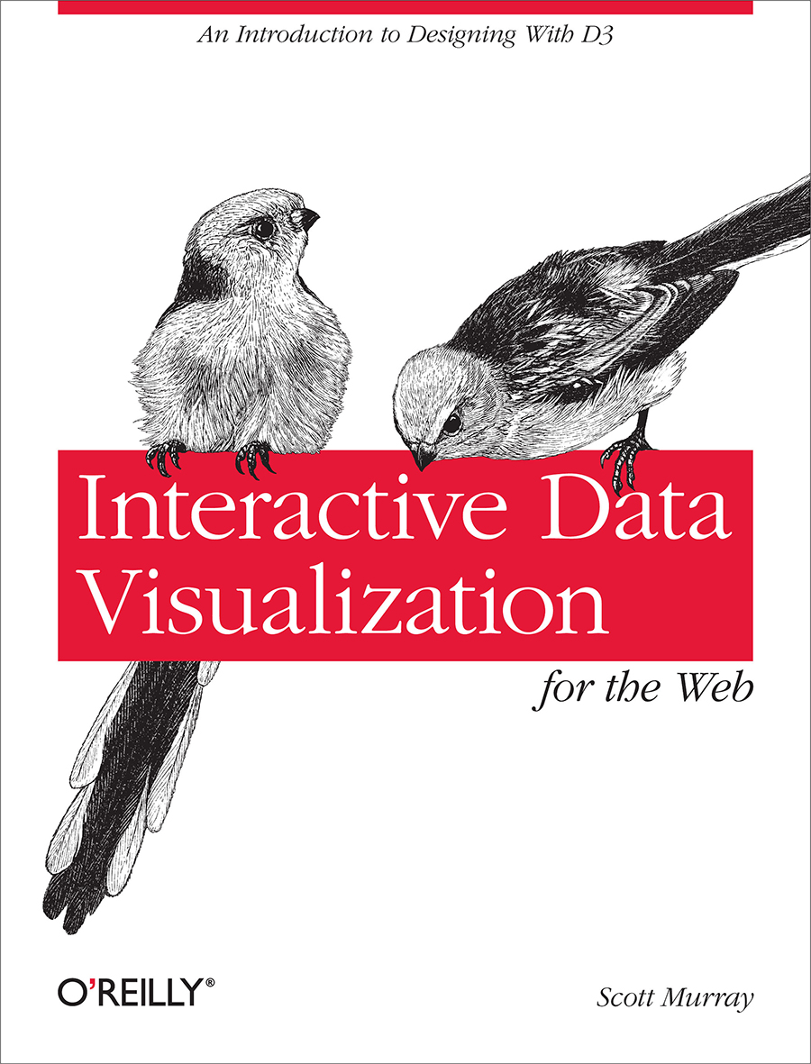
Recommended Texts

Slide 51
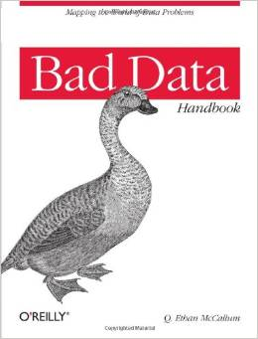
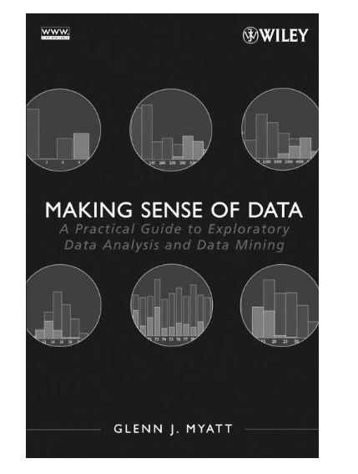
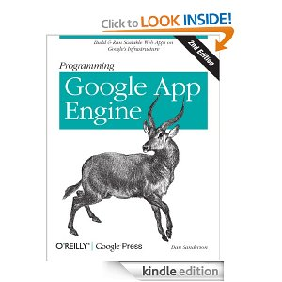
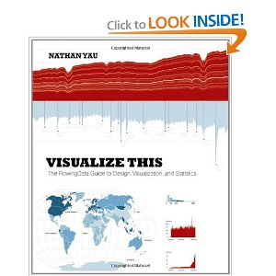
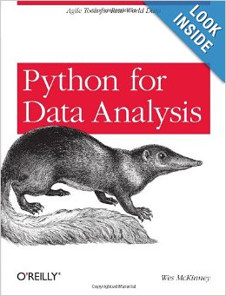
More books to consider

Slide 52
Where to find the class
Data.cmubi.org
https://github.com/jmankoff/data/
https://piazza.com/cmu/spring2015/05839/home
Blackboard
Note: Version control is your friend!!! You should consider joining github now, you will be required to use it for the bigger projects.

Slide 53
Where to find me
Newell Simon Hall 3612E
Office Hours: 10:30-11:30 Tuesdays; 1pm Thursdays
By appointment
Schedule: data.cmubi.org/calendar
Email: jmankoff@cs.cmu.edu

